Slide 1


Extra material
Author: Enrique Saiz Oubiña
Advisor: Manuel Antonio Sánchez-Montañés Isla

Slide 2
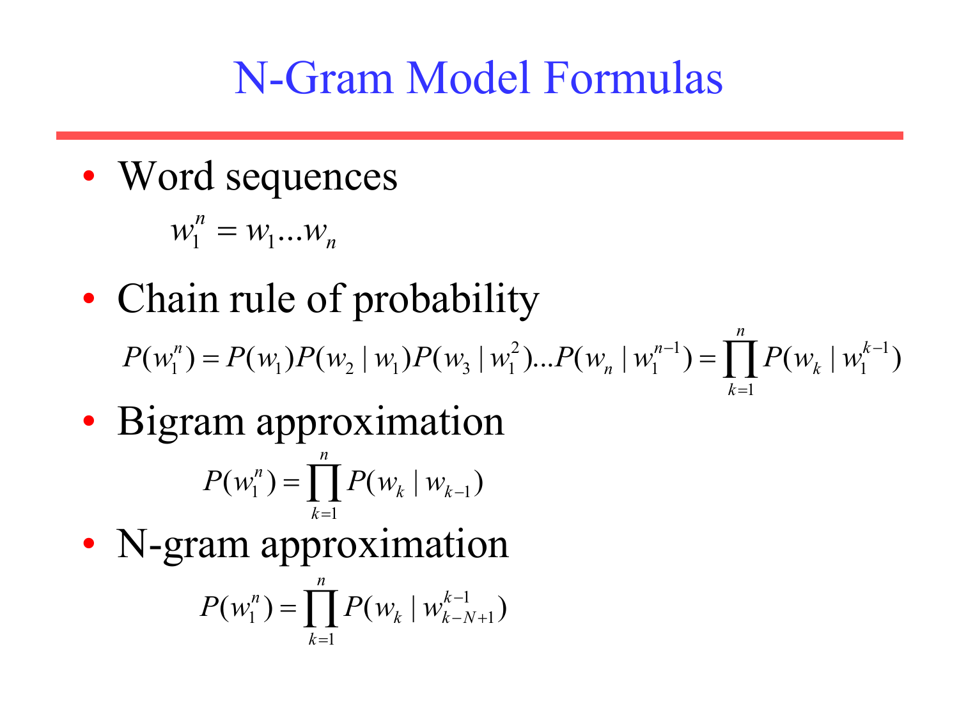
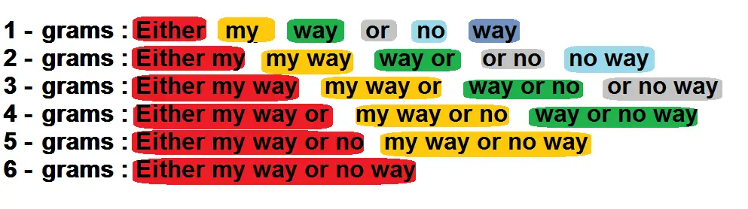
Statistical NLP: N-gram model
Extracted from https://machinelearningknowledge.ai/generating-unigram-bigram-trigram-and-ngrams-in-nltk/
Extracted from https://www.slideserve.com/wilmer/n-gram-model-formulas

Slide 3

Transformer
Extracted from https://jalammar.github.io/illustrated-transformer/
Notes:
The Split among heads is logical !!! How do we achieve it? Simple! Split with different weight matrices and apply linear transformation.
A linear transformation is merely the multiplication of input X by each weight matrix.
Weight matrices are learnable and they optimize performance on the task at hand.
Output weight matrix Wo is necessary to reduce the dimensionality of the concatenated outputs, and it is also learnable.

Slide 4

Transformer
Extracted from https://jalammar.github.io/illustrated-transformer/
Notes:
https://jalammar.github.io/illustrated-transformer

Slide 5

Transformer
Extracted from https://jalammar.github.io/illustrated-transformer/
Notes:
https://jalammar.github.io/illustrated-transformer/?ref=refind

Slide 6
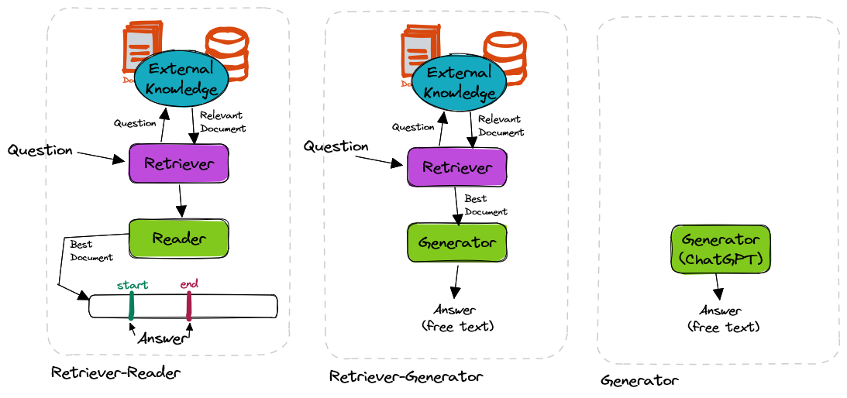
Question Answering systems
Extracted from https://shindeshu.github.io/posts/nlp/qa_guide.html#a-real-project-using-generative-qa

Slide 7
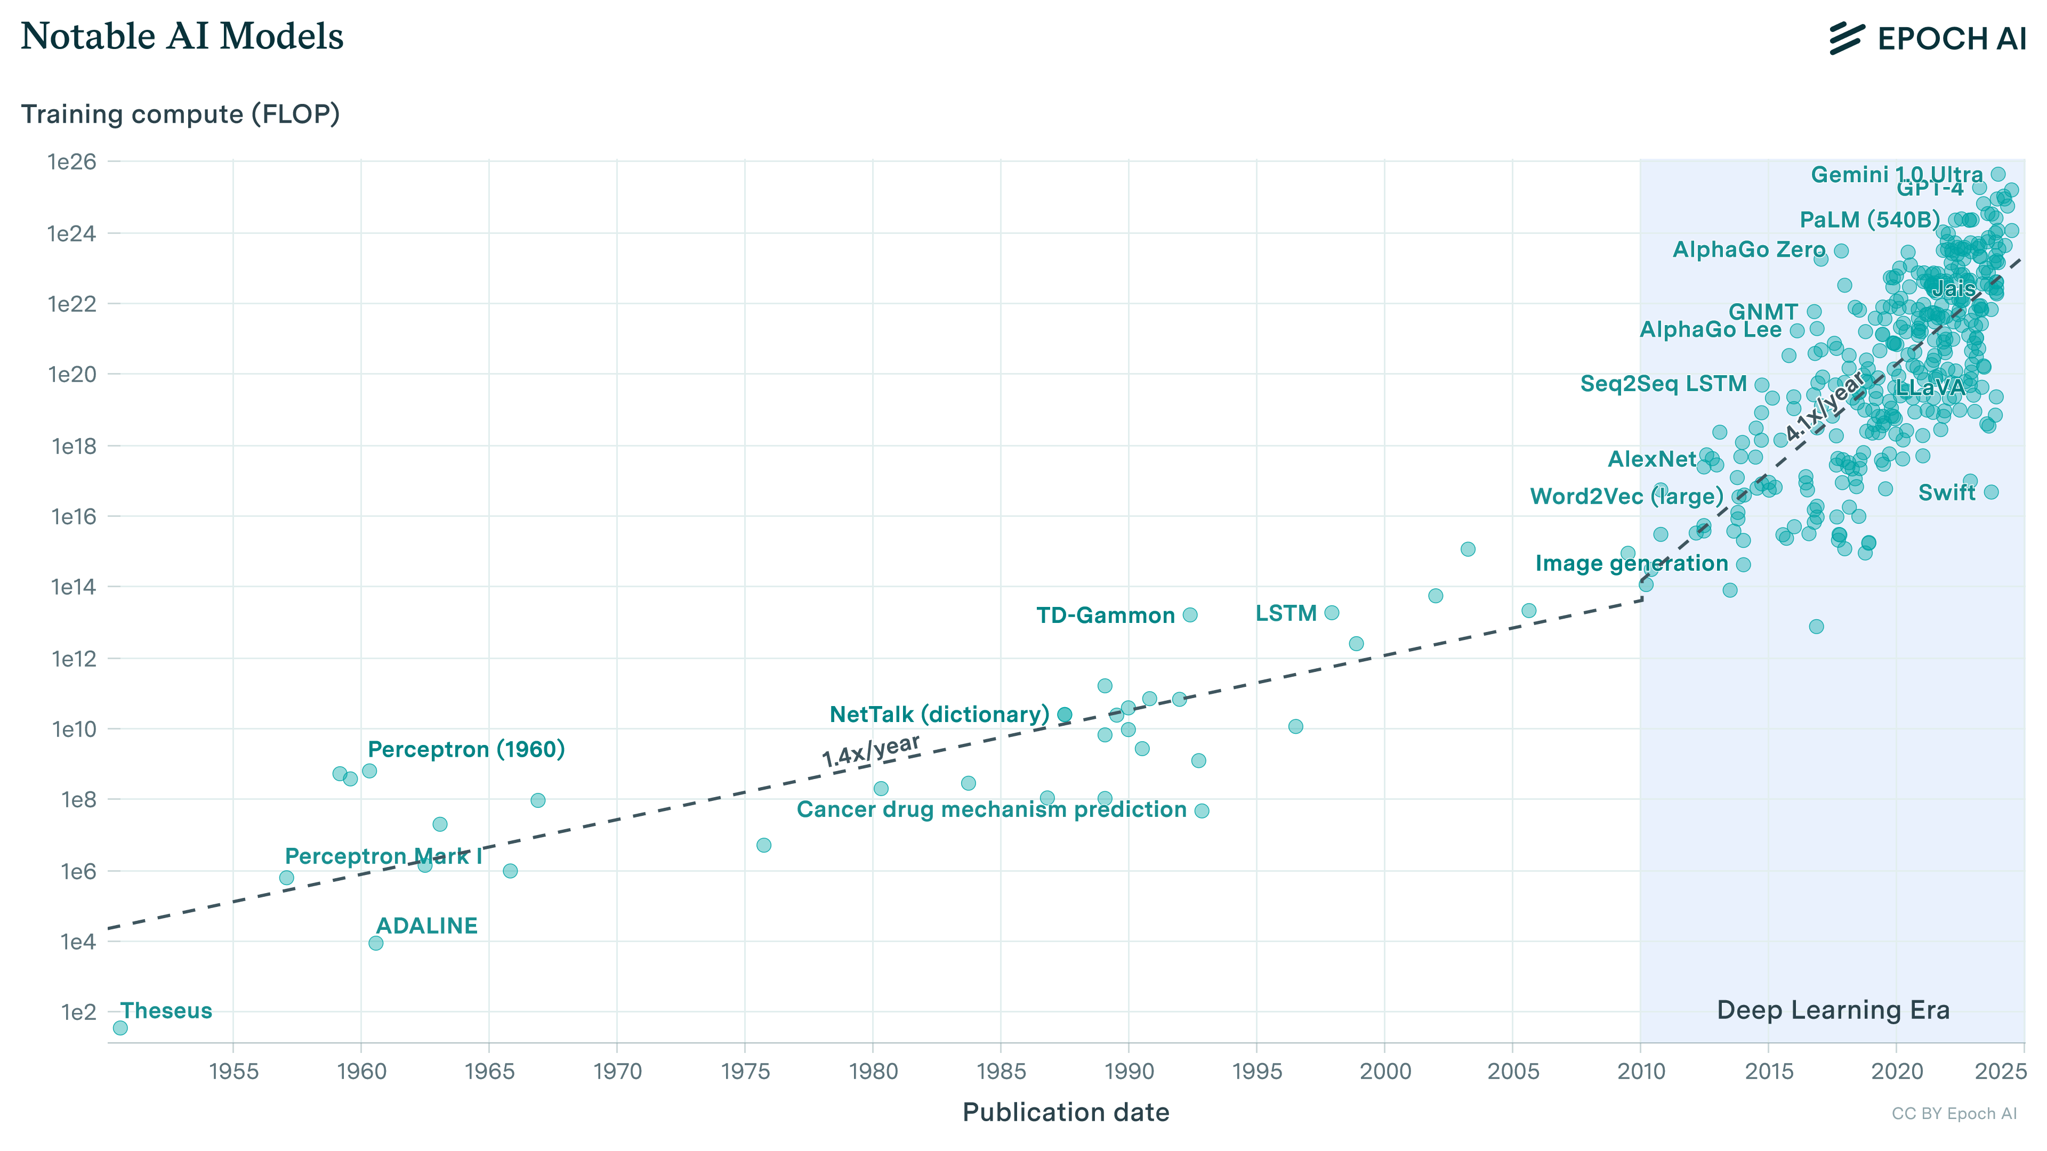
Evolution of LLMs
Extracted from https://epochai.org/data/epochdb/visualization?startDate=1972-5-4&startDlEra=2011-10-13
Notes:
Progreso notable machine laerning systems over time:
https://epochai.org/data/epochdb/visualization?startDate=1972-5-4&startDlEra=2011-10-13

Slide 8
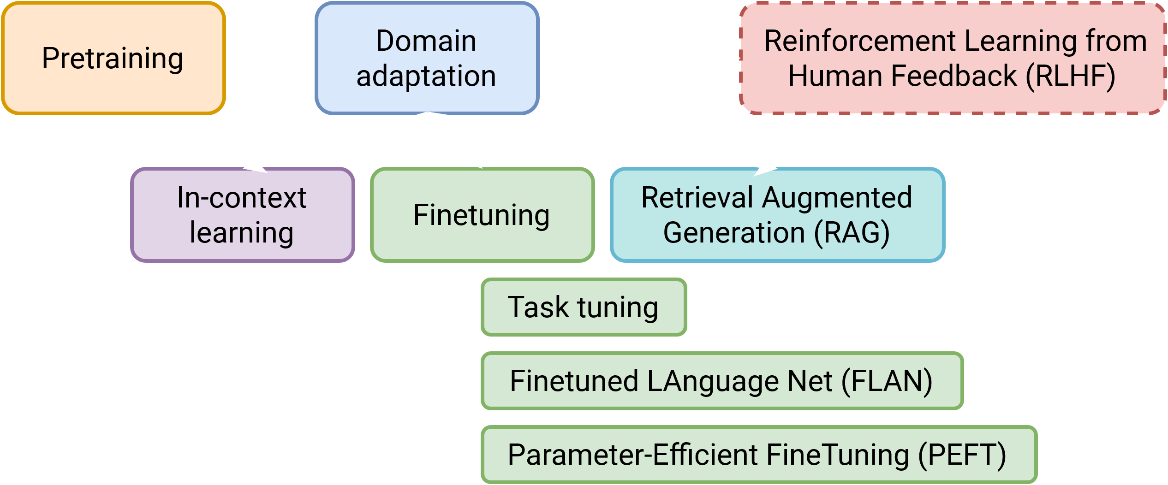
Training LLMs
Notes:
Rodear pretraining y finetuning

Slide 9
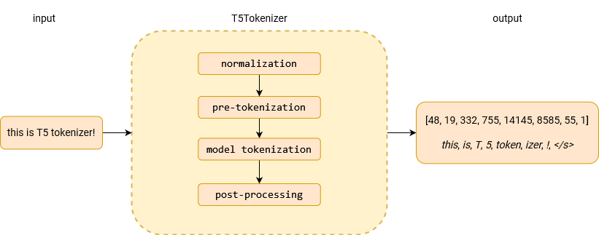
Tokenizers

Slide 10
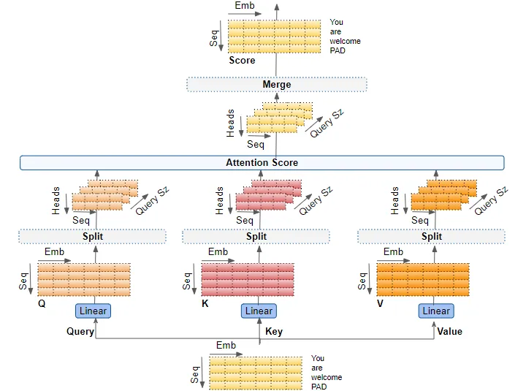
Attention mechanism
Extracted from https://www.53ai.com/news/hangyeyingyong/2024060449687.html

Slide 11

Attention demo
Attention demo
Notes:
https://colab.research.google.com/github/tensorflow/tensor2tensor/blob/master/tensor2tensor/notebooks/hello_t2t.ipynb
## Interpreting the Visualizations
- The layers drop down allow you to view the different Transformer layers, 0-indexed of course.
- Tip: The first layer, last layer and 2nd to last layer are usually the most interpretable.
- The attention dropdown allows you to select different pairs of encoder-decoder attentions:
- All: Shows all types of attentions together. NOTE: There is no relation between heads of the same color - between the decoder self attention and decoder-encoder attention since they do not share parameters.
- Input - Input: Shows only the encoder self-attention.
- Input - Output: Shows the decoder’s attention on the encoder. NOTE: Every decoder layer attends to the final layer of encoder so the visualization will show the attention on the final encoder layer regardless of what layer is selected in the drop down.
- Output - Output: Shows only the decoder self-attention. NOTE: The visualization might be slightly misleading in the first layer since the text shown is the target of the decoder, the input to the decoder at layer 0 is this text with a GO symbol prepreded.
- The colored squares represent the different attention heads.
- You can hide or show a given head by clicking on it’s color.
- Double clicking a color will hide all other colors, double clicking on a color when it’s the only head showing will show all the heads again.
- You can hover over a word to see the individual attention weights for just that position.
- Hovering over the words on the left will show what that position attended to.
- Hovering over the words on the right will show what positions attended to it.

Slide 12
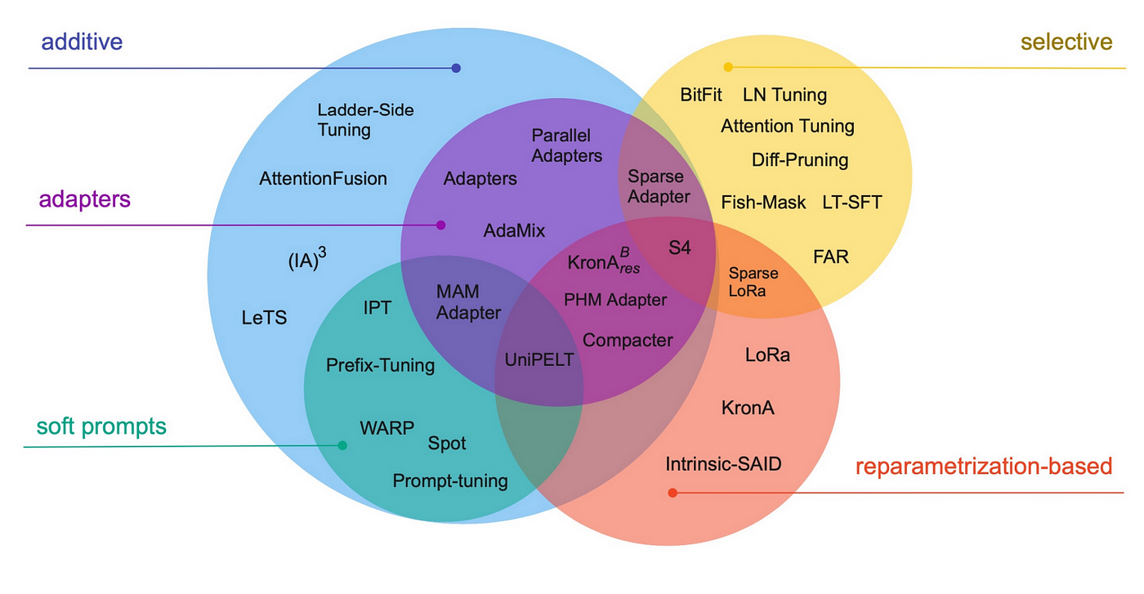
PEFT Methods
Extracted from https://arxiv.org/abs/2303.15647

Slide 13
PEFT, QLoRA and Phi
https://github.com/bala1802/Phi2
Notes:
https://github.com/bala1802/Phi2
more peft and qlora

Slide 14
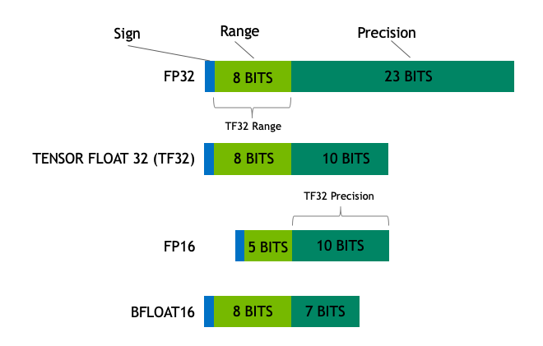
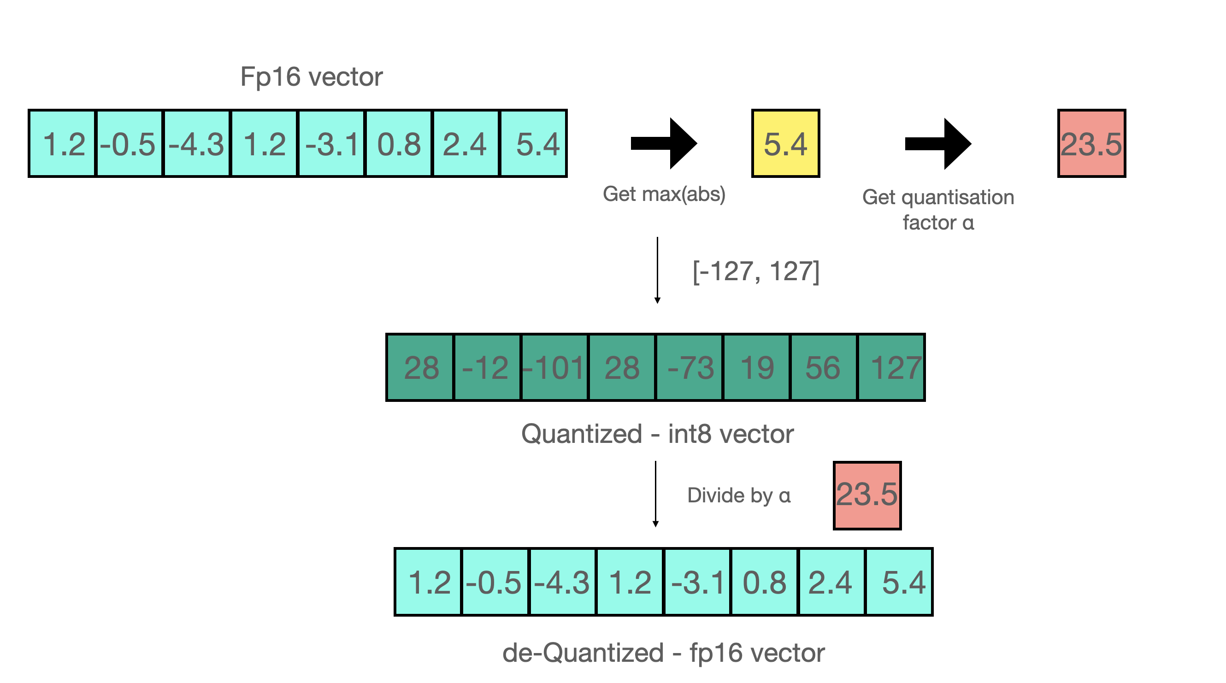
Quantization
Extracted from https://huggingface.co/blog/hf-bitsandbytes-integration

Slide 15

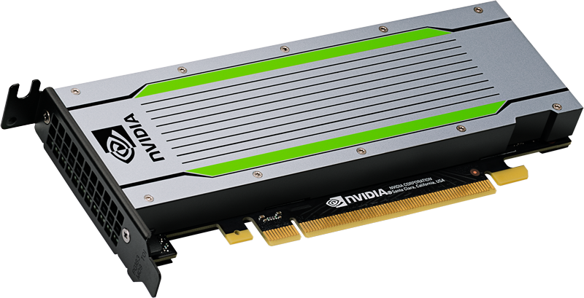
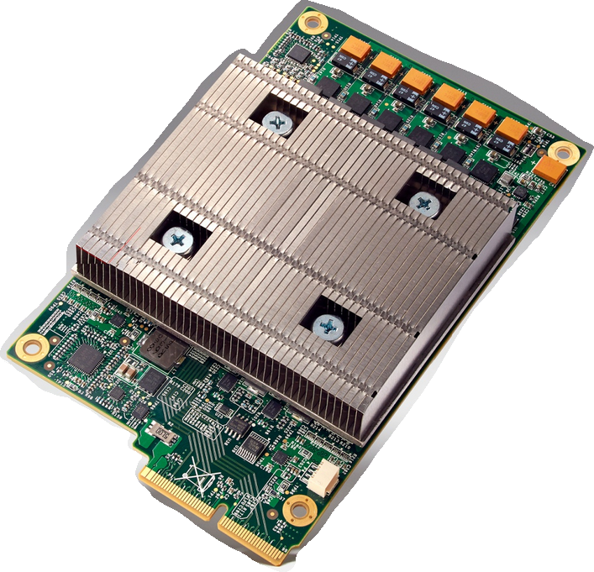


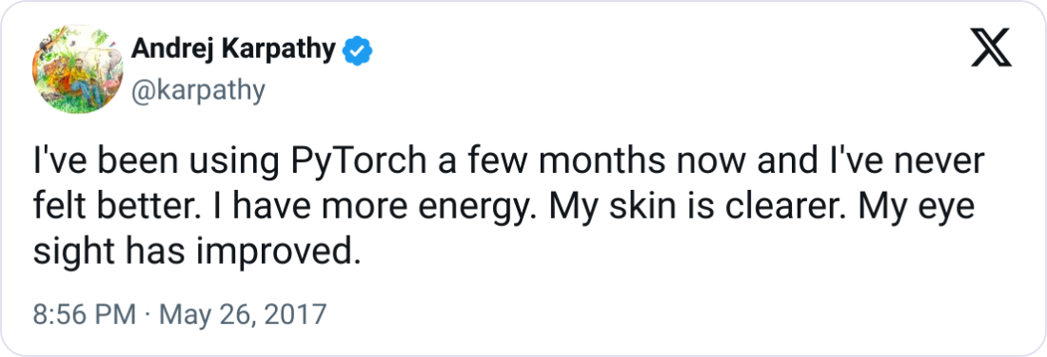
Technology and environment: decisions
vs.
vs.
T4 GPU
TPUv1
Pythonic and intuitive.
Many examples available.
Flexible and easy to pick up.
Andrej agrees:
Multiple accounts allowed.
Alternatives offer similar processors.
Usage limit resets within 2 days.
More availability.
More vRAM: 16 vs. 8GB.
Extracted from https://x.com/karpathy/status/868178954032513024
Notes:
Natural and pythonic: Sometimes, I was using pytorch and I didn’t even notice
Alternatives to colab: best is Kaggle (which is also google’s). Sessions are longer but only 1 account allowed (phone verification). Sessions reset weekly.

Slide 16
Tensor truncation and padding
Tensor need to be the same size in order to parallelize computations.
Truncate or pad the examples to a fixed length to solve this issue.
In decoder-only models, pad to the left to keep semantics.
<PAD> <PAD> <PAD> The capital of Spain is Madrid
The capital of Spain is <PAD> <PAD> <PAD> Madrid
Left padding
Right padding
Input
Prediction
Input
Prediction
In decoder-only models, since output becomes the input, right padding would break the sentences, difficulting the attention mechanism.

Slide 17
Experimental setup: finetuning RoBERTa
MRQA sample
2h18m53s
Base RoBERTa
Finetuned RoBERTa
1x T4 GPU
MRQA sample
2h25m39s
VMware’s
RoBERTa
Finetuned reference RoBERTa
1x T4 GPU
Reference model!
Notes:
Roberta mrqa
Roberta vmw mrqa
T5 base 16
T5 small
Flan t5 base 16
Flan t5 small
Phi 2
Phi 3

Slide 18
Experimental setup: finetuning T5
MRQA sample
2h56m32s
T5 Base
Finetuned T5 Base
1x T4 GPU
Half precision
Similar training size!
MRQA sample
2h49m43s
T5 Small
Finetuned T5 Small
1x T4 GPU
MRQA sample
2h49m57s
FLAN T5 Base
Finetuned FLAN T5 Base
1x T4 GPU
Half precision
Similar training size!
MRQA sample
2h40m27s
FLAN T5 Small
FLAN T5 Small
1x T4 GPU
Notes:
Roberta mrqa
Roberta vmw mrqa
T5 base 16
T5 small
Flan t5 base 16
Flan t5 small
Phi 2
Phi 3

Slide 19
Experimental setup: finetuning Phi
MRQA sample
3h27m3s
Base Phi-2
Finetuned Phi-2
1x T4 GPU
PEFT
MRQA sample
2h43m59s
Base Phi-3
Finetuned Phi-3
1x T4 GPU
PEFT
Notes:
Roberta mrqa
Roberta vmw mrqa
T5 base 16
T5 small
Flan t5 base 16
Flan t5 small
Phi 2
Phi 3

Slide 20
More examples
Context: "The rebellion of the city of Danzig was a revolt from December 1575 to December 1577 of the city against the outcome of the Polish-Lithuanian royal election, 1576. The Polish throne was contested by Stephen Báthory and the Holy Roman Emperor Maximillian II. It began on 12 December 1575 when Emperor Maximillian was chosen as monarch by the Polish Senate, while the majority of the szlachta had voted for Bathory. It ended on 16 December 1577. Maximilian’s II death in fall of 1576 weakened Danzig’s position and made the conflict less about the recognition of the ruler than about Danzig’s privileges. With neither side being able to defeat the other militarily, a compromise was reached, with economic as well as religious privileges of the city being restored and recognized, in return for a large reparation and recognition of Bathory as the king.“
Question: "What happened first, the end of the rebellion of the city of Danzig or Maximilian’s II death?“
Answer: "Maximilian’s II death“
RoBERTa prediction: "Maximilian’s II death" (EM: 100.0%, F1: 100.0%)
T5 prediction: "Maximilian’s II death" (EM: 100.0%, F1: 100.0%)
Phi prediction: "Maximilian’s II" (EM: 0.0%, F1: 80.0%)
Observations
Phi again shows generation issues.
Still, F1 proves to be reliable and highly scores its answer.
Notes:
Example from the DROP subset in the test split.

Slide 21
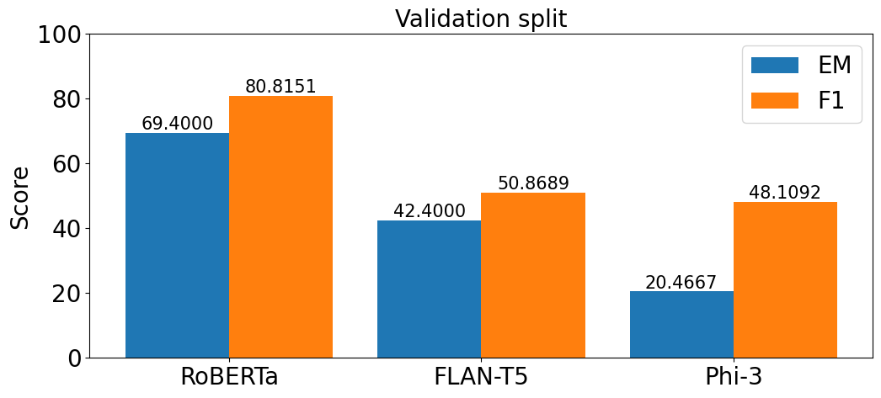
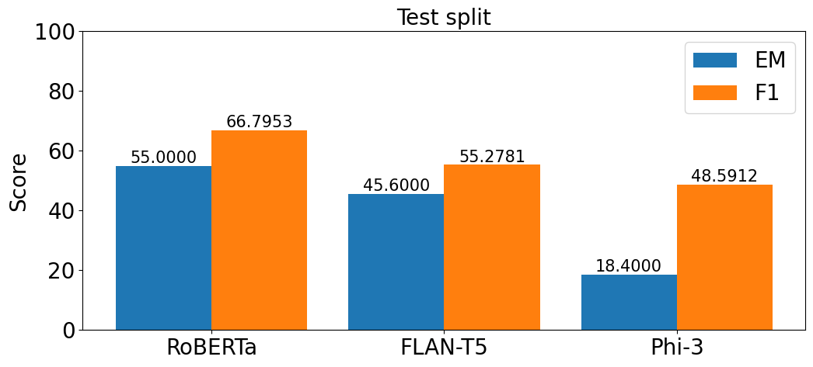
Results: best scores per family
Best RoBERTa model is the Finetuned reference model.
Best T5 model is the Finetuned FLAN-T5 Base at half precision.
Best Phi model is the Finetuned Phi-3.

Slide 22




Conclusions: future work
Employ more capable hardware to enhance results
For example, Google’s massive model PaLM was trained on 6144 TPUv4; TPUv4 > 30x T4. We used a single T4 during this work. Google, can I borrow one of your TPUs, please?
Implement complex evaluation methods
Methods such as semantic answer similarity may complement EM and F1 when they fail to assess the meaning of the answer.
Explore generative QA
We only tackled extractive QA, so the next step would be to adventure into generative QA by using a new dataset, decoder-based models and advanced evaluation techniques.
Further explore the NLP field
Plenty of work to be done in NLP: domain adaptation, RAG, reliable evaluation testbeds, local deployment of small models in mobile systems, etc.

Slide 23
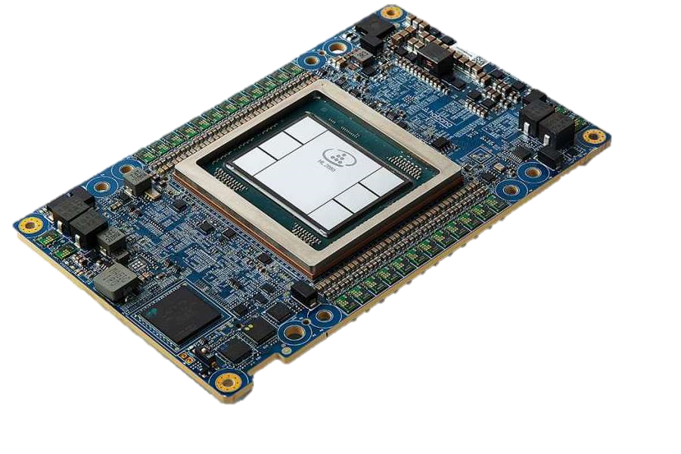
<
30x T4 GPU
1x TPUv4

